Slide 1
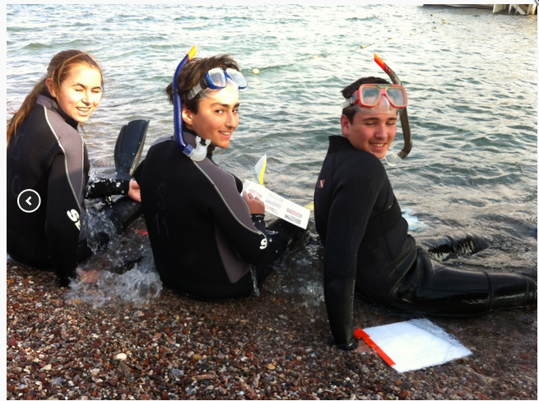
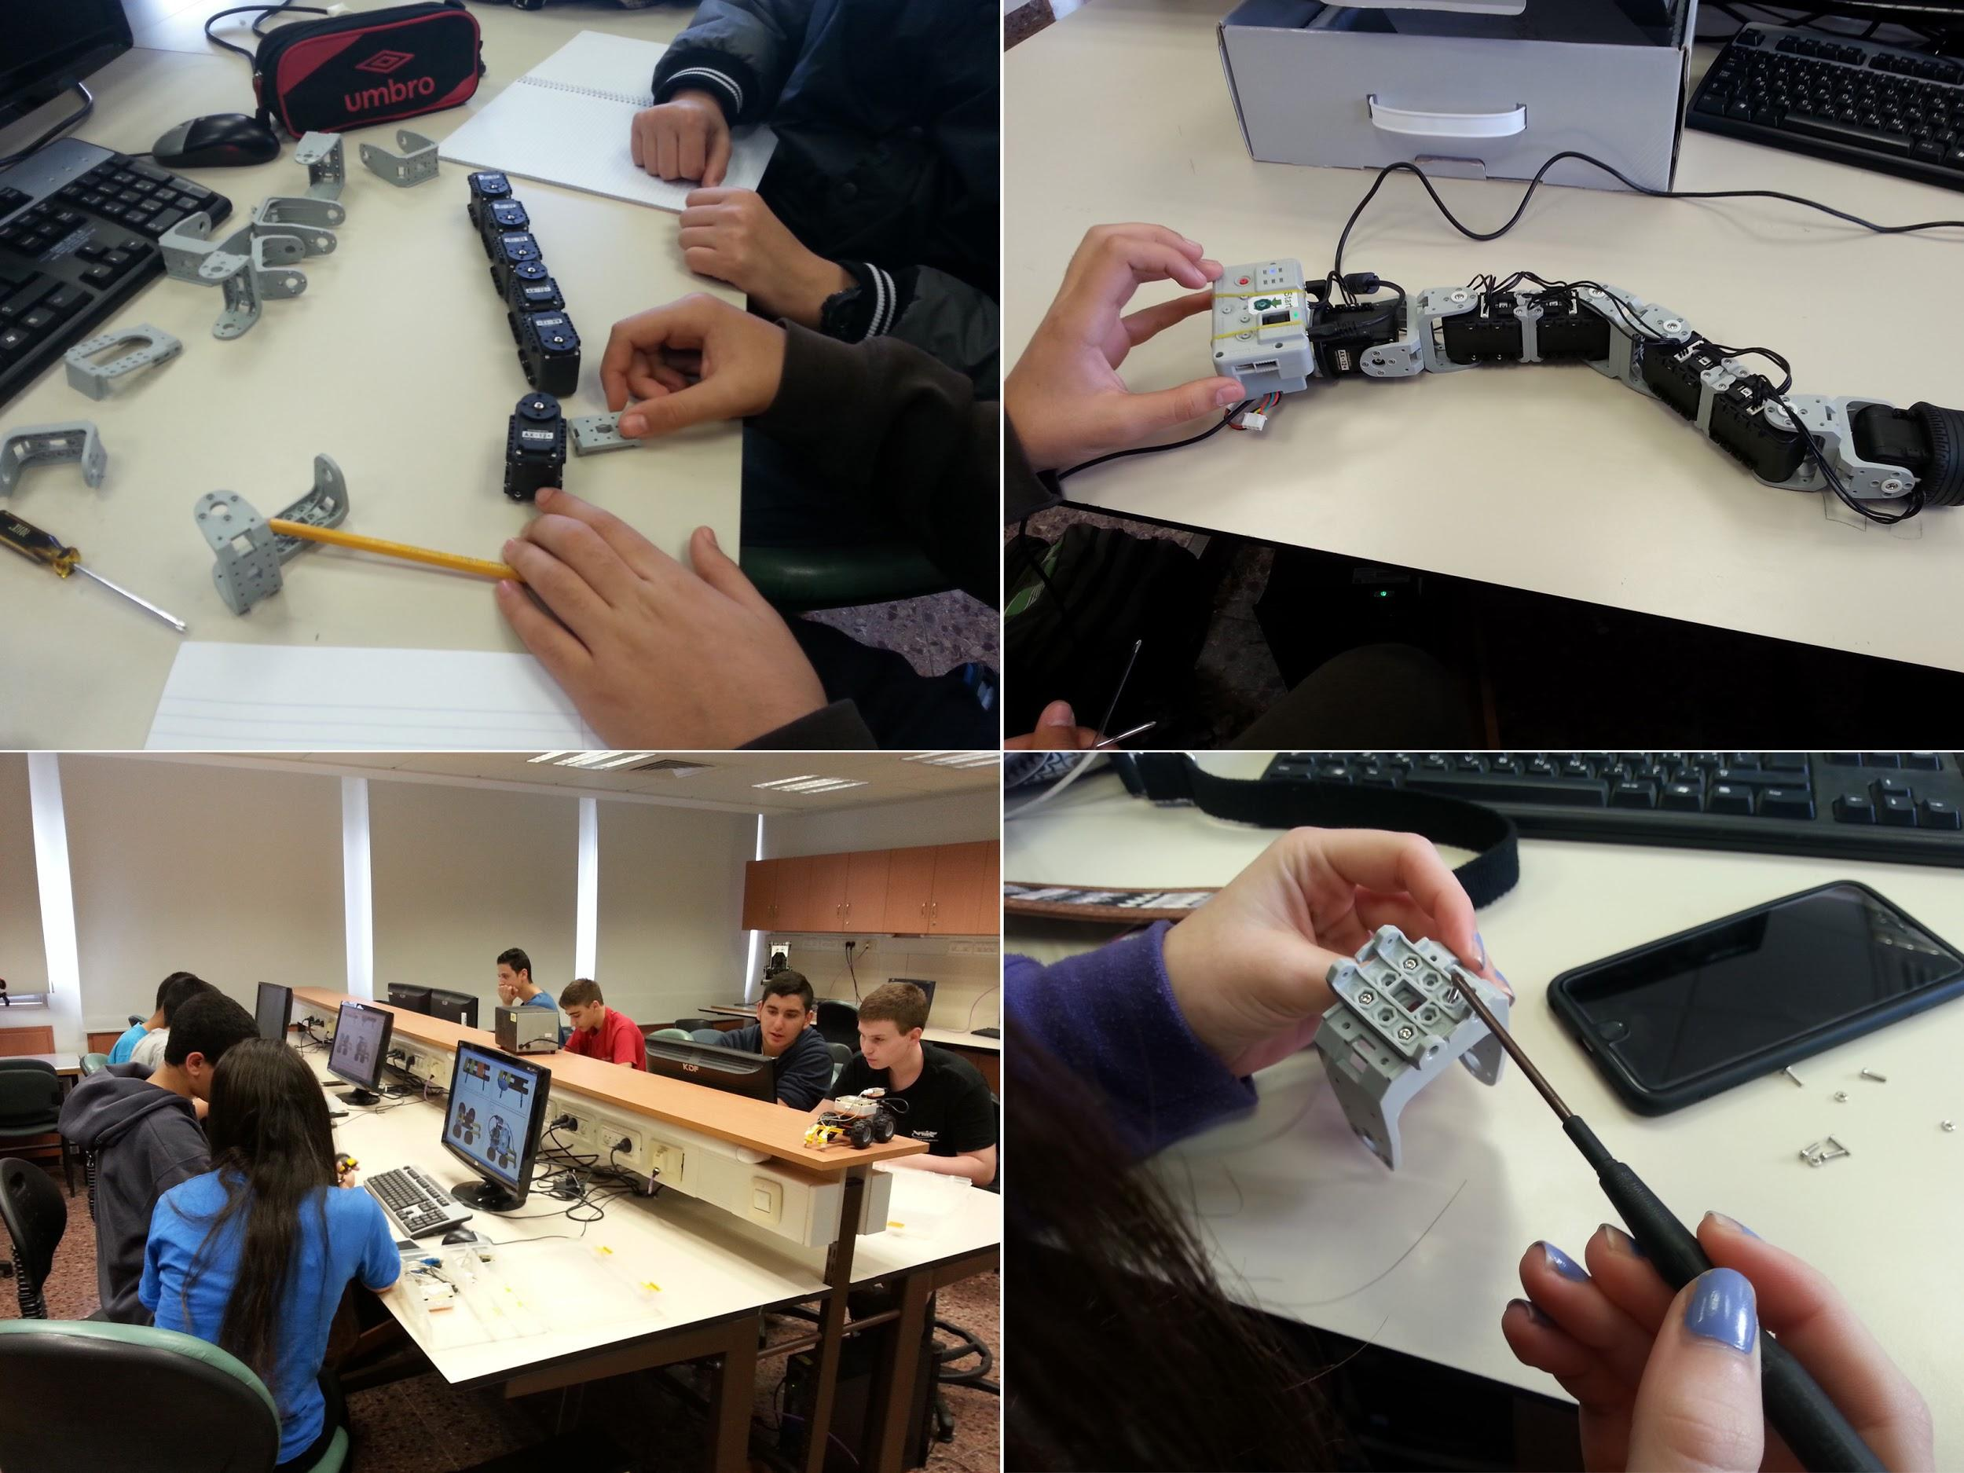
TanenbaumCHAT-Israel
Marine Biology & Robotics
Mini-mesters in Israel
November 22-December 3, 2015

Slide 2
The Centrality
of Israel

Slide 3
What is the program? | For whom? | When is the program? | Under whose auspices is the program? | Where is the program?
Marine Biology | Grade 10 students who are interested in biology, veterinary medicine, psychology, marine life | Sunday, November 22-Thursday, December 3 | Ben Gurion University in Eilat and the Inter-University Institute | Eilat
Robotics & Engineering | Grade 10-12 students who are interested in exploring medicine, biology, robotics, engineering | Sunday, November 22-Thursday, December 3 | The Technion University, Beit Yatziv, and Ben Gurion University | Haifa and the Negev region (Beersheva and Eilat, TBA)

Slide 5
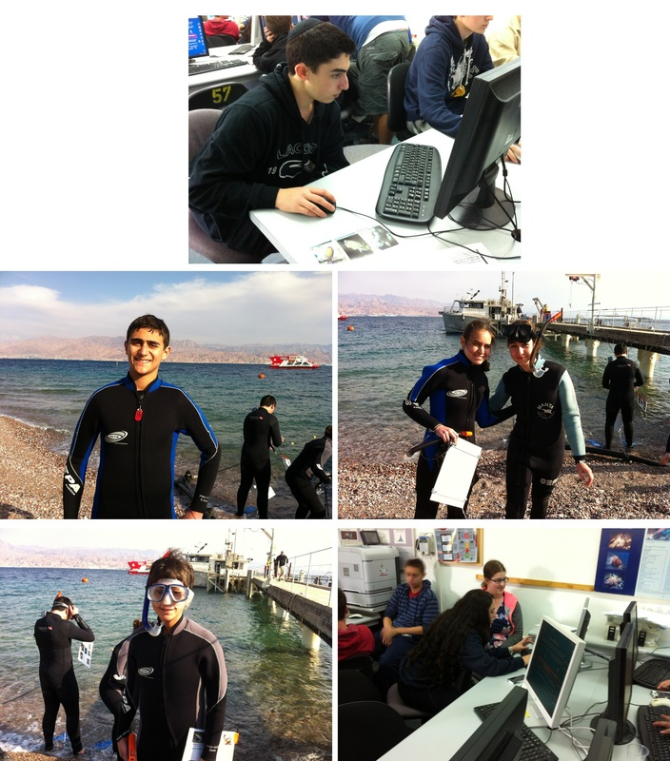
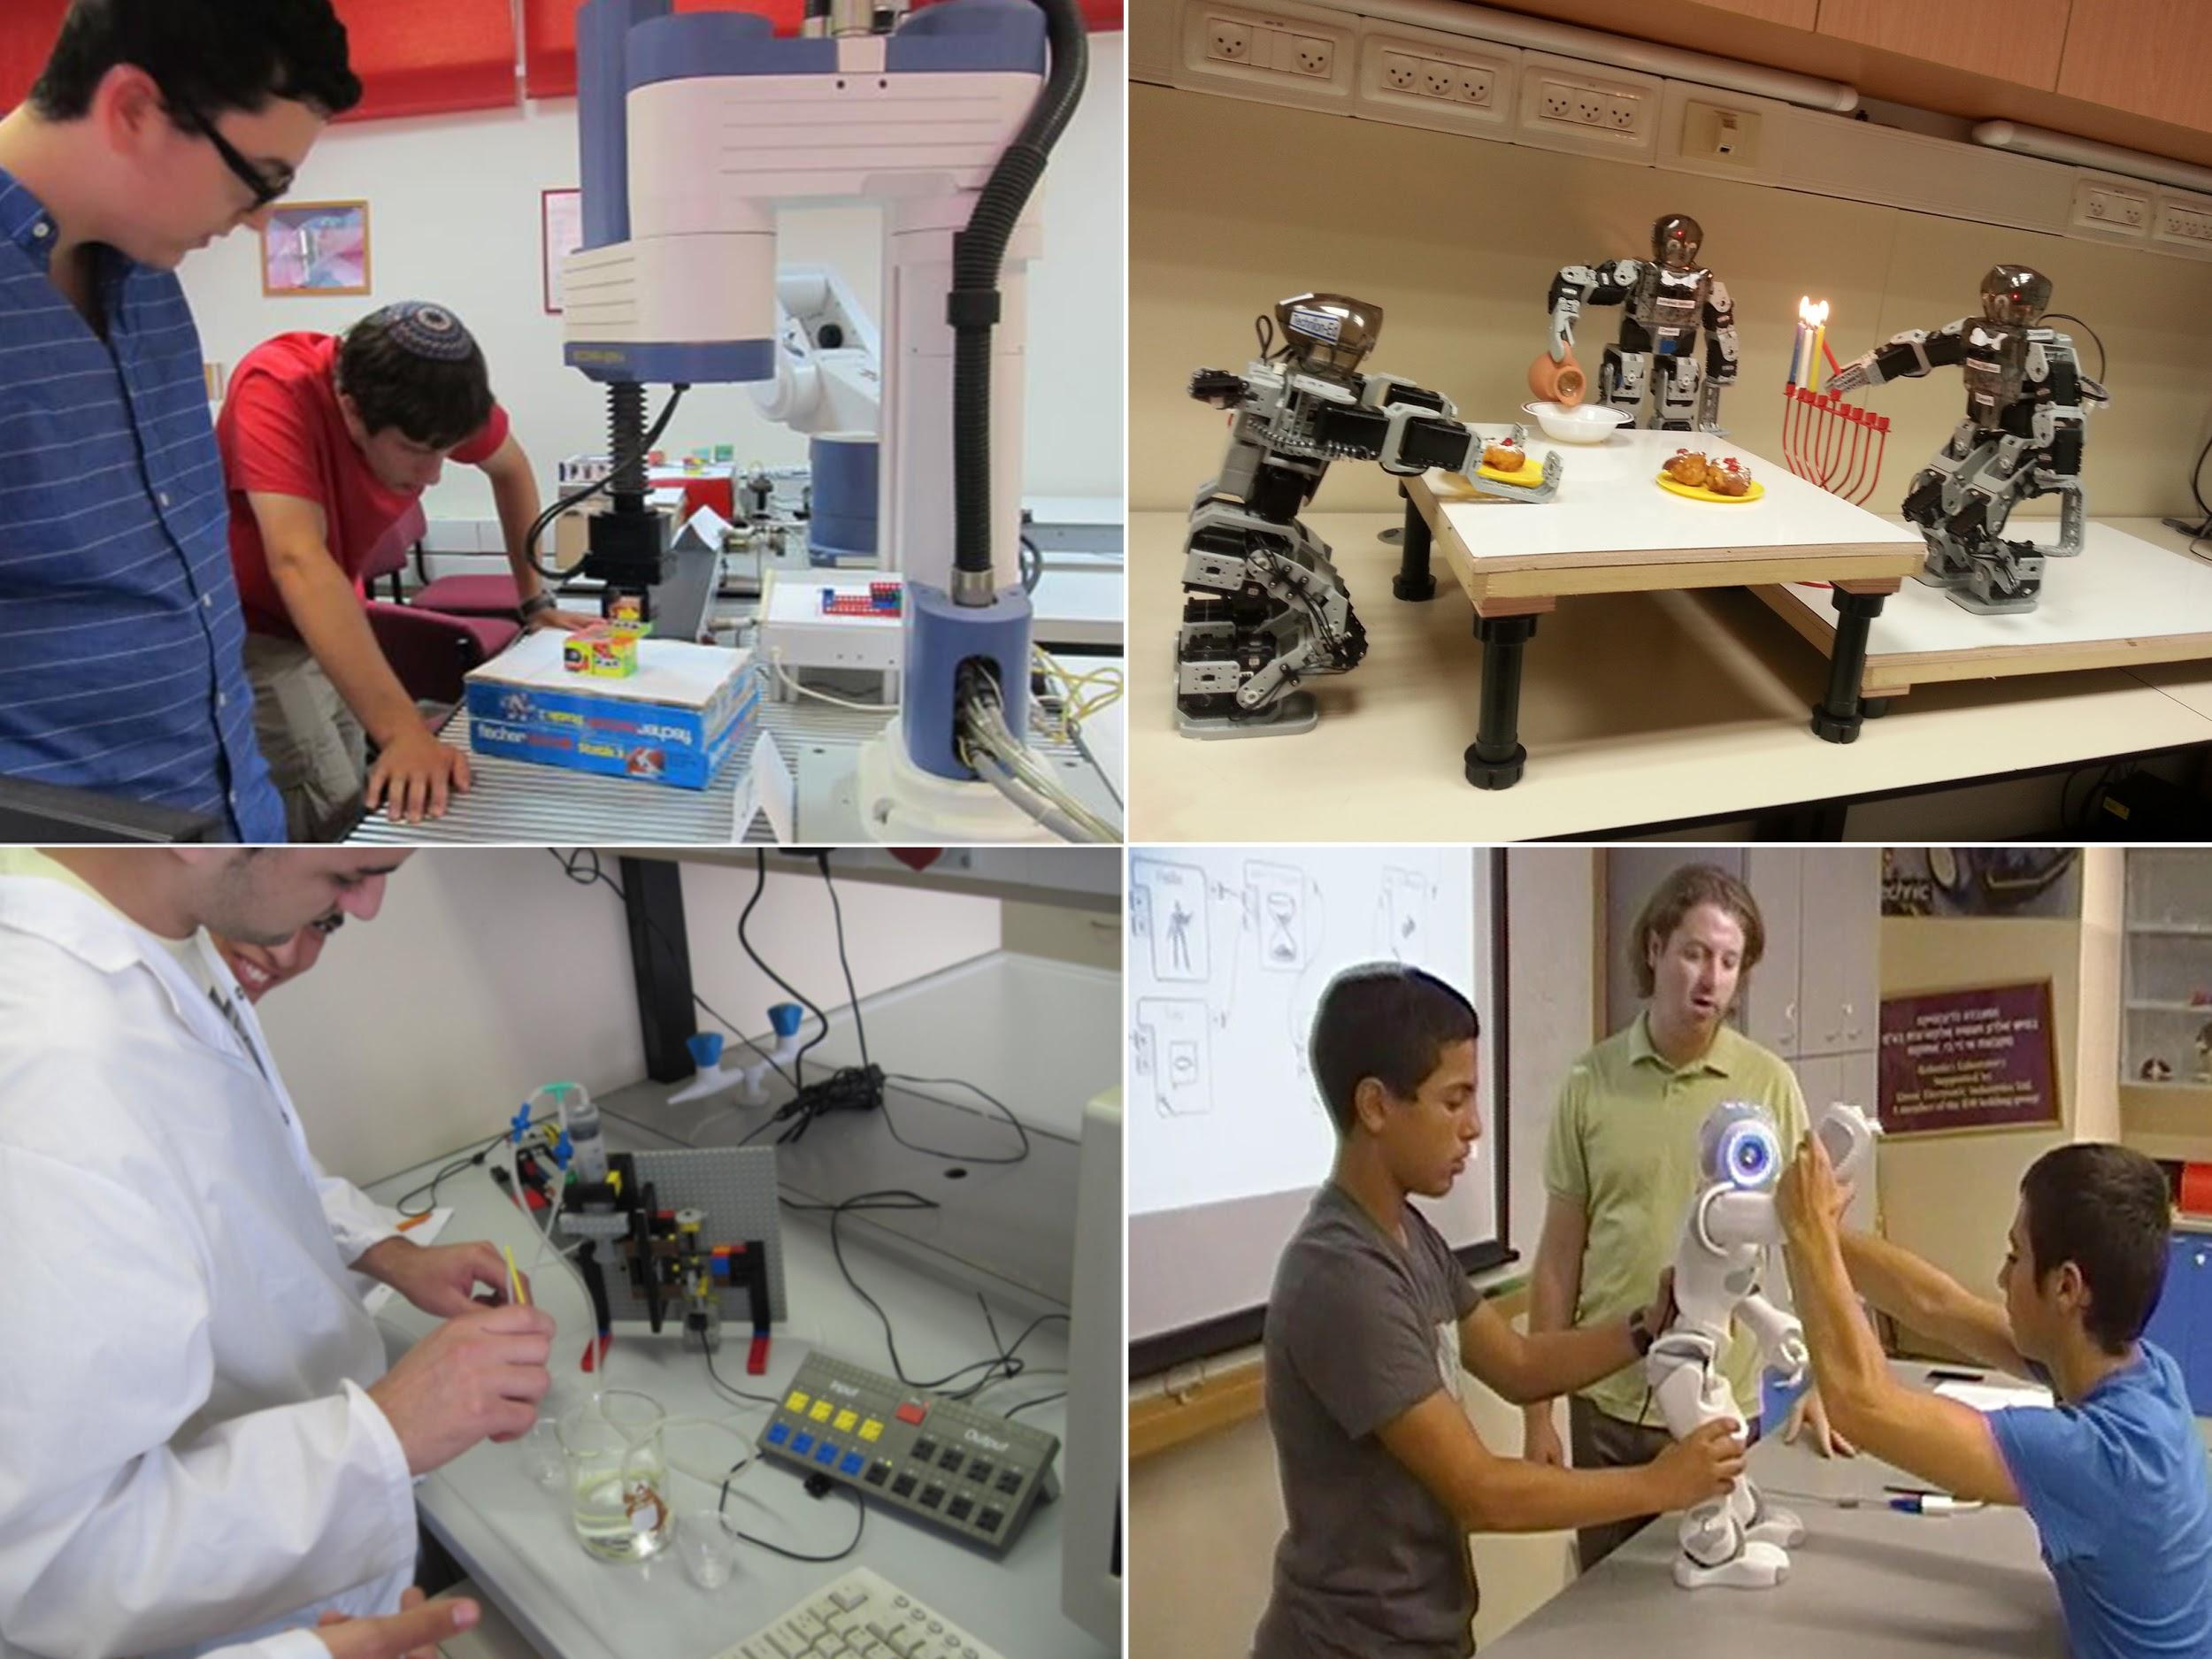
A curriculum-based experience focusing on authentic field research and project-based learning in sciences.

Slide 6
In conjunction with
Ben Gurion University-Eilat
The Inter-University Institute for Marine Sciences
The Technion-Israel Institute of Technology
Ben University-Beersheva
Beit Yatziv

Slide 7
Tentative Schedule
Sunday | Monday | Tuesday | Wednesday | Thursday | Friday | Saturday
22 Depart Toronto 5:45 pm | 23 Arrive at Ben Gurion University 11:55 am Marine Bio heads to Eilat Robotics heads to Haifa | 24 Research & Project Day 1 | 25 Research & Project Day 2 | 26 Research & Project Day 3 Head to Jerusalem | 27 Erev Shabbat in Jerusalem | 28 Shabbat
29 Both groups head to Eilat | 30 Research & Project Day 4 | 1 Research & Project Day 5 | 2 Research & Project Day 6 Depart for Ben Gurion Airport | 3 Depart Ben Gurion Airport 12:45 am Arrive Pearson Airport 6:30 am | 4 School Day

Slide 8
Overview of Robotics Program
The goals are to learn how robots can be and are utilized in daily life and in cutting edge inventions that address simple and more complex authentic problems; to learn how to build robot models that perform a range of functions; to visit sites where robots are applied to real-life situations.

Slide 9
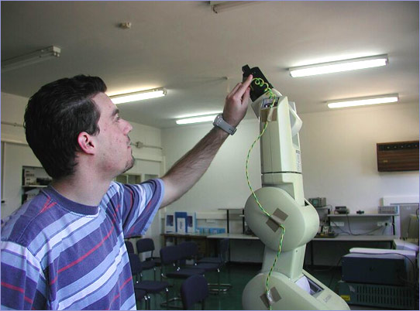
The Technion: The Center for Robotics and Digital Technology Education
Introduction of robotics and how to construct robots
Automation of science laboratory experiments
Robotic models of biological systems
Robotics for training spatial skills

Slide 10
Ben Gurion University
Submarine Robotics
Apps for iPhone
Robotics Labs at Ben Gurion University

Slide 11
Beit Yatziv
Preparation for FRC (First Robotics Competition)
Mini-robot competitions
Integration of Goldwater HS students
Industry visits

Slide 12
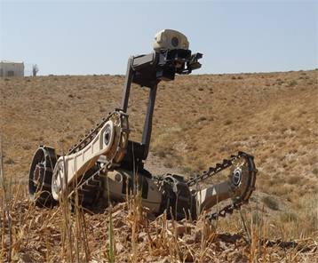
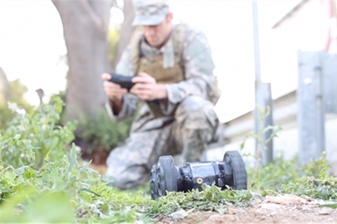
Sample Industry Visit
Roboteam designs, develops and manufactures cutting edge, user-oriented, multi-purpose, unmanned platforms and controllers for Defense, Law Enforcement and Public Safety missions. Our team includes dozens of highly experienced engineers that are dedicated to creating units that provide complete operational and tactical control, overall mission management and enhanced force coordination..
We created a line of lightweight, fast deployable unmanned ground systems that deliver technological and functional breakthroughs for tactical purposes with unmatched reliability. Among our customers one can find top units within the US Military, Special Forces, EOD units and SWAT teams as well as other elite units around the globe.

Slide 13
https://youtu.be/6npUYTxWuRM

Slide 14
Eligibility requirements
Preparation beforehand (academic reading; tech skills training; other prep as required)
Expectations on the campus
Academic expectations (ISA)
Blogging rotation
Expectation to bring it back to TannenbaumCHAT
Basic swimming skills for marine biology track

Slide 15
Logistics
Phone
iDevices
Visitors
Passport
Health, safety, certificate of completion, security, lodging, spending money
Chaperones

Slide 16
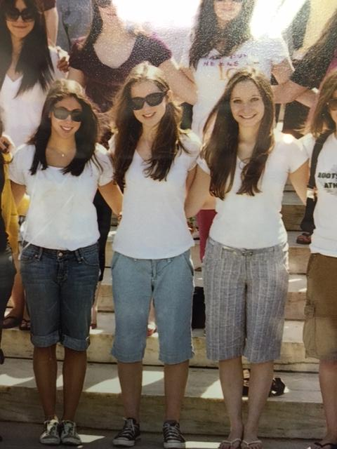
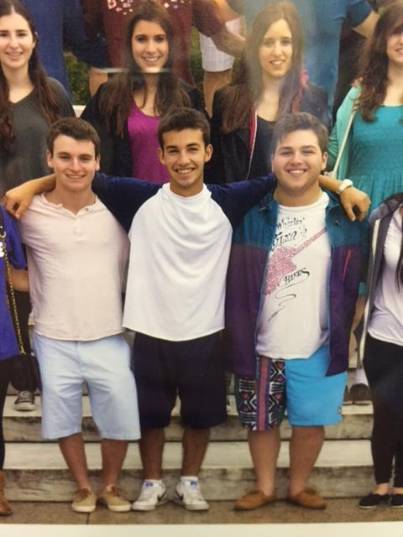
Handbook Rules
Dress Code

Slide 17
Handbook Rules
Shabbaton rules apply on Shabbat
Optional daily Tefillah
Kashrut

Slide 18
Price
Last year was approx. $3,400 USD
($3,800 CAD)
Thank you again to UJA and the Chai Family

Slide 19
Timeline and Deadlines
Sept. 11 – PowerPoint presentation will be sent via email
Sept. 25 – Price will be finalized, announced in parents newsletter; online app goes live
Oct. 2 – Online application and $1,000 USD payment is due
Oct. 16 – Balance due with all forms (medical; emergency; dietary; visitation forms; rooming)

Slide 20
Questions?

